Slide 1




Lean Into the
Curve by Applying
Experimental IT
Principles
EXPONENTIAL
AI STRATEGY
Strategic and actionable principles to enable IT leaders to extract the value from accelerating technology advancements.
The Exponential Linear Curve
STRATEGY & INNOVATION
GOVERNANCE RISK & COMPLIANCE
1980
2010
2030
Capitalize on the commoditization of IT
Drive dynamic risk informed decisions
PARADIGM SHIFT IN THE ORGANIZATION
EXPONENTIAL IT TRAJECTORY
COMPUTERIZATION
DIGITALIZATION
AUTONOMIZATION
PROJECT & PORTOFOLIO MANAGEMENT
ENTERPRISE ARCHITECTURE
IT FINANCIAL
& VENDOR MANAGEMENT
Organizations adopt PCs and networks at scale
The internet allows ubiquitous connectivity
AI renders organizational capabilities autonomous
PARADIGM SHIFT IN THE ROLE OF IT
Automate and focus on high value activities
Deliver organizational capabilities
Shift from Technology in capabilities
TRUSTED OPERATION
ORGANIZATIONAL PARTNER
ORGANIZATIONAL PARTNER
IT helps the organization automate the back office and create efficiencies
IT enables the transformation of business and service models and the creation of digital value
IT accelerates value creation by embracing exponential technologies
PEOPLE & LEADERSHIP
DATA & ARTIFICIAL INTELLIGANCE
SECURITY
& PRIVACY
Lead transformation in a Tech-first Enterprise
Make data capabilities a differentiator
Shift from reactive to predictive
ALGORITHMS
INTERNET
VIRTUALIZATION
CLOUD
BIG DATA
NLP & IMAGE RECOGNITION
GENERATIVE AI
APPLICATIONS
INFRASTRUCTURE & OPERATIONS
EXPONENTIAL TECHNOLOGY ADVANCEMENTS
Move from applications to organizational capabilities
Focus on value over assets
LINEAR IT TRAJECTORY
1980
2010
2030

Slide 2







AI STRATEGY
Lead Your Ai Transformation
AI is an existential transformation – transform or be left behind
Demonstrate the right to lead
Move from Al-enhanced
productivity to Al-driven product and service development
Unprecedented
levels of investment
Deeply understand your core business operating model and the disruption to everything you do
While most organizations view an AI transformation as a productivity play, true success will come to those who manage to transform their offerings by providing hyper-personalized products and services to customers. Transformative AI is about products and services, not productivity.
Scalable capabilities
Invested globally by 2025 in implementing new AI technologies and reshaping business models
ML & AI operations
AI Strategy
$200B
Strategic alignment
Data operations
AI Value cases
Unprecedented
Speed of change
AI & data platforms
Stay up to date with evolving AI tech and vendor landscape
Measure of success
Personalization of
products and services
5 days
The time it took OpenAI to achieve one million customers for ChatGPT. Facebook took 10 months
Harness your proprietary data and augment its value
Whoever leads with AI wins.
Unprecedented
Depth of impact
Earn the right to play
PRIORITY
Governed foundations
Change adoption
Product and service strategy
70%
The number of people McKinsey has estimated AI could displace from their jobs by 2030
True personalization
Hyper-loyalty and hyper-adoption
Empathic products and services
AI risk
Evolving maturity of AI vendors
Unprecedented rate and pace of change
Massive human impact of AI change
Executive priority
Unique characteristics of an AI transformation
BYPRODUCTS
Which one do you want to be?
AI governance
Ai literacy & skills
Productivity strategy
Optimized operations
Disruptor
Disrupted
Responsible principles
Change planning
Unlimited opportunities for accelerating growth
Digital Darwinism –bleak future for those left behind
Self evolving design
Autonomous & optimal
Proactive self healing

Slide 3
AI STRATEGY
Completed
Retain
Modify
Discontinue
Evaluation of Current Strategic Plan
5/9
5
2
2
GOAL 1
Enhance Competitive Advantage Through AI Innovation
COMPLETION
RECOMENDATON
INTIATIVES
Retain
Modify
Discontinue
1-A
Develop and deploy advanced generative AI models for product innovation.
Completed
1-B
1-B : Implement AI-powered customer segmentation to personalize marketing strategies.
Not Complete
1-C
Establish an AI-driven supply chain optimization platform.
Completed
GOAL 2
Improve Operational Efficiency With AI Automation
COMPLETION
RECOMENDATON
INTIATIVES
Retain
Modify
Discontinue
2-A
Integrate AI chatbots for customer support automation.
Completed
2-B
Deploy AI-driven predictive maintenance for equipment.
Not Complete
2-C
Implement AI-based workforce management tools.
Not Complete
GOAL 3
Build AI Capabilities Across the Organization
COMPLETION
RECOMENDATON
INTIATIVES
Retain
Modify
Discontinue
2-A
Launch an internal AI training program for employees.
Completed
2-B
Develop an AI ethics framework to guide responsible AI usage.
Completed
2-C
Create an AI Center of Excellence to centralize expertise.
Not Complete

Slide 4


AI STRATEGY
Core Competency to Leverage
VALUE
RARITY
IMITABILITY
ORGANIZATION
Competitive Advantage
Core Competency
Does it benefit customers?
Is it distinctive in the market?
Is it hard to duplicate?
Can we equipped to use it effectively?
Personalized AI solutions
High
Moderate
Easy to replicate
Well-integrated
Short-term edge
X
Exclusive data insights
High
High
Difficult to replace
Strong capabilities
Long-term advantage
Agile product innovation
High
Common
Easy to replicate
Efficient team
Competitive
X
X
Core Competency Strengths
Areas For Improvement
Offers deep insights into customer behavior and market trends.
Invest in advanced algorithms to make personalization more dynamic.
Provides highly tailored experiences that resonate with customer needs.
Expand the scope of data sources to capture broader market signals.
Facilitates faster time-to-market for innovative solutions.
Strengthen collaboration between AI teams and product developers to ensure alignment.

Slide 5


AI STRATEGY
Identification of Top Strategic Priorities
Shared Values
Approach
Structure
Schemes
Style
Staff
Ability
Key Observations
Shared Values
Embedding principles like transparency, fairness, and accountability into AI development and deployment.
Approach
Structure
Integrating AI into key business processes to drive efficiency, growth, and competitive advantage.
Schemes
Creating cross-functional teams and roles dedicated to AI implementation and governance.
Style
Investing in data management systems, computing resources, and AI platforms to enable seamless integration.
Staff
Ability

Slide 6
AI STRATEGY
Observers
50-60%
Front-Runners
30-40%
Innovators
<10%
THE JOURNEY
Conventional cloud transformation, at-scale migration of apps, followed by modernization and native app development.
AI innovation on the cloud over a “Data on Cloud” foundation.
Long-term, end-to-end AI transformation unlocked by building a modern AI tech stack.
13
14
12
11
Conventional trajectory
10
9
2-3X
AI-empowered trajectory
OUR CURRENT POSITION
8
ROI
Value Realization
6
7
4
5
Circles 1-14 plot industry competitor momentum
3
AI Strategy Value Trajectory
1
2

Slide 7
AI STRATEGY
Impact Analysis of Key Factors
Rising adoption of Al and automation
Low
Medium
High
DRIVERS
Increasing investments in cloud and edge computing
Low
Medium
High
Shortage of skilled AI and ML engineers
Low
Medium
High
RESTRAINTS
High dependence on legacy synergies
Low
Medium
High
Expansion of Al-powered enterprise solutions
Low
Medium
High
OPPORTUNITIES
Integration of Blockchain and Web3 technologies
Low
Medium
High

Slide 8
AI STRATEGY
STRENGTH
WEAKNESS
STRATEGIC IMPLICATIONS
Strategic Group Mapping
Strong focus on cutting-edge AI research
Limited market penetration
Likely to dominate high-end markets
Competitor A
Competitor B
Robust portfolio of AI-driven products
Slow pace of innovation
Must accelerate innovation to maintain relevance.
Radical (+)
A
C
Cost-effective AI solutions
Limited investment in advanced AI
Needs to invest in innovation to differentiate offerings
Competitor C
B
Competitor D
Agile development approach
Narrow focus on specific verticals
Should explore partnerships to expand
AI ADOPTION
Our
Company
E
Expertise in data analytics
Relatively slow decision-making processes
Requires streamlining operations to remain agile
D
DISRUPTIVE INNOVATORS
Competitor E
F
Competitor F
Pioneering open-source AI frameworks
Dependence on community contributions
Struggles with enterprise-level reliability
Incremental (-)
SUSTAINING INNOVATORS
OUR COMPANY
Leverage radical AI adoption
Maintain incremental improvements
Balance innovation with operational efficiency
Niche (-)
MARKET SCOPE
Board (+)

Slide 9
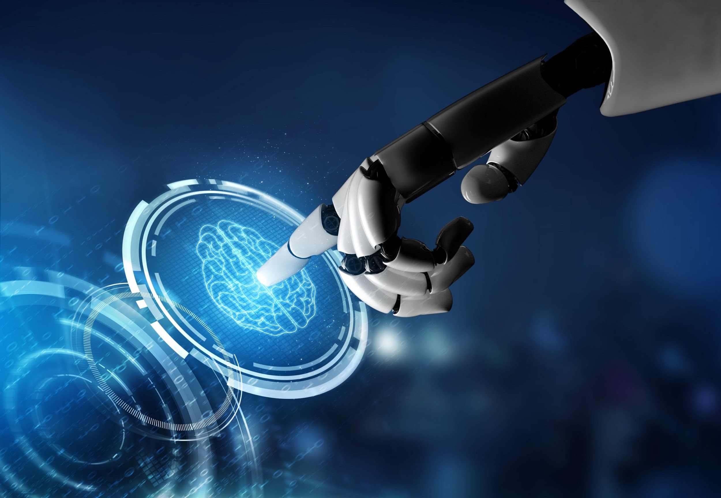
AI STRATEGY
Strategic Goal
Enhance operational efficiency through Al integration
MAIN INTIATIVES
Automate Routine Tasks Using AI-Driven Workflows
Implement Predictive Maintenance for Critical Equipment
Optimize Supply Chain Operations with Real-Time Data Insights
ROLLOUT PLAN
SUCCESS METRICS
Current
Goal
Q1
Q2
Q3
Q4
2
60%
85%
1. AUDIT
Conduct an audit of current processes to identify automation opportunities.
2. PILOT
Pilot AI solutions in selected departments to test effectiveness and scalability.
3. SCALE
Scale successful pilot projects across the organization to maximize impact.
4. REFINE
Refine and optimize AI implementations based on feedback and performance metrics.
EXPECTED OUTCOME
68%
4 hrs / wk
35%
40%
20%
2X
SYSTEM IDLE TIME
PROCESS AUTOMATION RATE
PREDICTION ACCUURACY
Operational
Turnaround Time
Overall
Functioning Costs
Throughput for Key Process

Slide 10
AI STRATEGY
Strategic ROI
STRATEGIC INITIATIVE
INVESTMENT
PROJECTED ROI
1
Implement AI-driven automation tools
$500K
-82%
+37%
Operational Savings
Productivity Gains
SHORT-TERM
-15%
Reduce operational costs and improve productivity.
1
2
$300K
-36%
+33%
Time Saving
Error Minimization
Use predictive analytics to allocate resources
Operational Cost
3
Deploy AI-powered data platforms
$200K
+11%
+31%
Scalability
Operational Agility
1
Develop AI-driven recommendation engines
$750K
+42%
+55%
Revenue Growth
Customer Retention
MID-TERM
2
+22%
Use AI analytics to identify high-potential markets
Leverage AI to expand market reach, enhance customer engagement.
2
$600K
+20%
+15%
Market Penetration
Sales Conversion
Revenue
3
Implement AI-powered sales tools to optimize lead generation
$400K
+10%
+5%
Cross-Selling
Brand Loyalty
1
Collaborate with academic institutions
$2M
+40%
+5%
Thought Leadership
Innovation Pipeline
LONG-TERM
Position the organization as a leader in AI innovation.
3
+13%
Develop training programs and incentives to upskill
+3
-37%
Competitive Edge
Intellectual Property
2
$3M
Market Share
3
Create proprietary AI solutions that differentiate the organization
$1M
+25%
+10%
Brand Reputation
Future-Readiness

Slide 11
AI STRATEGY
Al Initiative Matrix
Familiar
DRIVE & EXPAND
ACCELERATE GO TO MARKET
UNICORN – INVEST HEAVILY
Distinctive knowledge surpassing customers, invests in initiatives already owned by the company or easily acquired
ADAPT CORE
A
Sustain and enhance existing business
A
A
Digital process optimization
Customer experience enhancement
Core product line expansion
Supply chain resilience
A
SELECTIVELS DRIVE & EXPAND
PLAN GO TO MARKET
INCREASE INVESTMENTS
Unfamiliar
A
Competitors are better, but small investments are made to gain familiarity
B
TIME
B
B
BUILD NEW BUSINESS
Invest in emerging opportunities to drive medium-term growth
B
B
New market entry
Innovative product development
Strategic alliances and partnerships
Ecommerce expansion
Eco-friendly product alternatives
B
C
NO GO ZONE
SELECTIVE PLAN GO TO MARKET
LONG TERM R&D INVEST
Uncertain
C
Success is difficult to estimate, but a good bet if successful
C
C
SHAPE OVERALL PORTFOLIO
Long term bets on transformative opportunities
1-2 years
2-3 years
3+ years
C
Invest In emerging technologies
Strengthen market position via M&A targets
Business model disruption
Meet current earnings expectations
Extend & defend core
Create medium term growth
Operationalize processes
Generate portfolio of high-return options
Create long-term growth
TIME

Slide 12
AI STRATEGY
R1
AI Model Failure
Category
Extreme (16)
Faulty AI outputs could lead I biased decision-making, regulatory scrutiny, and customer distrust.
Potential Risk of Strategic Plan
Strategic Risk Type
R,O
Priority
High
STRATEGIC
R =
Reputational
F =
Financial
O =
Operational
RISK TYPE
C =
G =
R2
AI Model Failure
Competitive
Governance
Category
Very High (15)
A data breach could result in financial loss, legal penalties and serve reputational damage.
Strategic Risk Type
G, R, F
Almost Certain
5
10
15
20
25
Priority
High
R3
AI Model Failure
4
8
12
16
20
Category
Medium (8)
Service outages could disrupt customer operations, leading to loss of trust and potential revenue impact.
Likely
R4
R1
Strategic Risk Type
O, C
Priority
Manageable
3
6
9
12
15
PROBABILITY
Moderate
R5
R2
R4
AI Model Failure
Category
High (12)
Non-compliance with AI ethics laws could lead to fines, operational restrictions and reputational damage.
2
4
6
8
10
Strategic Risk Type
G, F
Unlikely
R2
Priority
High
R4
AI Model Failure
Rare
1
2
3
4
5
Category
Medium (9)
Expansion failure could lead to lost investments, difficulty penetrating new markets, and failing customer needs.
Strategic Risk Type
C, F
Insignificant
Minor
Significant
Major
Severe
Priority
Monitor & MTGT
IMPACT

Slide 13
AI STRATEGY
Al Strategy implementation is expected to be carried out over the next 5 years
FTE NEEDS
PHASE 1
PHASE 2
PHASE 3
PHASE4
Scenario A
Scenario B
Scenario C
Scenario D
Year 1
Year 2-3
Year 4
Year 5
GROUNDWORK
ACCELERATION
GROWTH
OBJECTIVE
Scale AI adoption across key business functions and drive measurable improvements in operational efficiency and decision-making.
Embed AI into the organization's DNA by integrating it into core business strategies and fostering a culture of innovation.
Conduct a comprehensive audit
Develop or enhance data pipelines
Provide foundational training on AI concepts
Launch small-scale AI pilots
Identify and implement AI-driven solutions
Strengthen data management
Scale successful AI solutions
Invest in R&D
Implement ongoing training programs
INITIATIVE

Slide 14

AI STRATEGY
1
BUSINESS
UNDERSTANDING
Validation Failed
Validation Passed
DATA GATHERING
Gather high-quality data from diverse sources to fuel AI models.
VALIDATION
DATA PIPELINE
2
4
Indicates that the model or solution worked or not
AI STRATEGY
Build robust pipelines for data ingestion, transformation, and storage.
DATA
ACQUISITION
IMPLEMENTATION CYCLE
DEPLOYMENT
PRODUCT INTEGRATION
DATA VALIDATION, CLEANUP
How the product is integrated in the system?
Clean and preprocess data to ensure accuracy and consistency.
3
Data Engineer
DATA EXPLORATION, ANALYSIS
MODEL
DEVELOPMENT
Data Scientist
Analyze data to identify patterns, trends, and insights.
Product Engineer
FEATURE ENGINEERING
MODEL TRAINING
MODEL TRAINING
Create meaningful features from raw data to enhance model.
Train AI models using labeled data and make predictions.
Evaluate model performance using test datasets.

Slide 15
AI STRATEGY
Strategy Map Overview
Cut operating costs with AI-driven process and resource optimization
Financial
Grow high-margin AI subscription revenue streams via new tiered service models
Elevate product reliability and customer satisfaction with AI-powered proactive support systems
Launch advanced AI features and personalized services to capture emerging markets
Customer
Automate core workflows with intelligent robotic agents
Implement predictive maintenance analytics to minimize downtime
Process
Deploy ML-Ops pipeline governance to expedite model delivery
Scale cross-functional AI product squads for rapid rollout
Upskill technical teams in automation, data engineering, and advanced ML-Ops best practices
Learning
Develop data-savvy innovation focussed leaders to drive continual innovation breakthoughs

Slide 16


AI STRATEGY
Resource Allocation Plan
5%
10%
Training & Talent
20%
Compliance & Risk
40%
10%
Customer Succes
SHORT-TERM
LONG-TERM
Show Detail
60%
Digital Infrastructure
Process Automation
20%
15%
Product Development
To maintain essential business survival
20%
For regular business growth and expansion
To bring strategic transformation for market leadership

Slide 17
AI STRATEGY
Resource Allocation Plan (Long-Term)
TIMELINE
Y1 – Y3
Y3 – Y6
Y6 – Y10 +
HORIZON
SURVIVE
EXPAND
TRANSFORM
Period Outlook
Stabilize and optimize current core business
Accelerate growth and further market reach
Transformative innovations to disrupt industry
Strategic Focus
Operational stability & continuous improvement
Scalable innovation and market expansion
Radical disruption and industry leadership
Complexity
Uncertainty
Business Impact
Optimize system performance & security
Enhance user experience with iterative updates
Streamline internal processes with automation
Pioneer next-gen technologies
Develop new disruptive business models
Set industry standards in ethical innovation
Expand product adoption in new markets
Strengthen automation capabilities
Build strategic partnerships for growth
Strategic Initiatives
Resource Allocation
50%
20%
30%

Slide 18
AI STRATEGY
Execution Dashboard
GOAL: Establish data ecosystem and foundational
Al capabilities to drive consistent insights
65%
33%
15%
35%
75%
9%
Action Items for Goal
Assigned
Status
Progress
A.1.1 | Develop data ingestion pipelines | Team lead | On Track
A.1.2 | Cleanse and validate datasets | Data Engineer | At Risk
 | Reduce missing data fields | Data Engineer
A.1.3 | Implement feature engineering strategies | Data Scientist | On Track
 | Ensure features are interpretable | Data Scientist
A.1.4 | Train initial machine learning models | MIL Specialist | On Track
A.1.5 | Integrate models into production systems | DevOps Engineer | Needs Review
A.1.6 | Monitor model performance and optimize | QA Analyst | On Track
 | Reduce false positives/negatives | QA Analyst
-
-
70%
15%
-
82%
53%
51%
-
POWERSLIDES WWW.POWERSLIDES.COM
18

